Slide 1

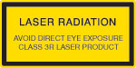
“The objective of this Society shall be to advance the arts, sciences, and technology of precision engineering, and to promote its dissemination through education and training, and use by science and industry……”
ASPE student challenge
Class 3R lasers produce visible and invisible light that is hazardous under direct and specular-reflection viewing conditions. Eye injuries may occur if you directly view the beam, especially when using optical instruments. Lasers in this class are considered safe as long as they are handled with restricted beam viewing. The MPE can be exceeded with this class of laser; however, this presents a low risk level to injury. Visible, continuous-wave lasers in this class are limited to 5 mW of output power.

Slide 2
Goals of the student challenge
Challenge new talent that understands the basic precision engineering principles by requiring hands-on design and build of prototypes that demonstrate those principles.
Teach the importance of team collaboration, project management, troubleshooting and keeping it simple.
Provide an environment for the students to interact with peers from leading schools from around the world in precision engineering in an informal setting.
Provide an environment for the students interact with our aging world experts in an informal setting – important connections so they can follow up for advice.
Opportunity to have students see the benefits of working in precision engineering developing new devices.
Show students cases and ideas operating at the limit of technological capability that do not have to be very expensive and to experiment and build devices that are deterministic per design.
Give companies access to a larger pool of talent in the areas of precision engineering.
Give them the opportunity to work with a team with limited resources and time so they can
value the importance of focusing on the important aspects of the project.
Encourage students to apply theory and use their own hands to quickly prototype devices.
Encourage students to learn many of the enabling technologies like hardware programing, data acquisition and analysis.
Fabrication of apparatus using modular subsystems for solving multi-faceted tasks.
Prepare and inspire underrepresented graduate and undergraduate students to pursue a career in the precision engineering area.
Providing students at universities that do not have precision-engineering-related research activities access to non-traditional tools of precision engineering. Consequently, it provides an experiential exposure to methods and current technologies in this discipline.

Slide 3
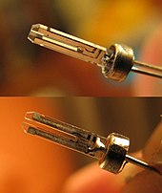
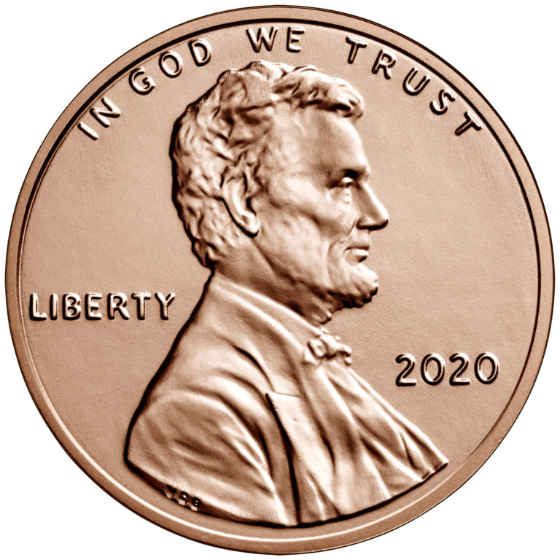
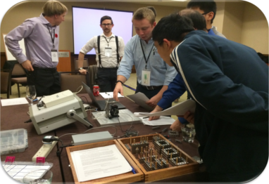
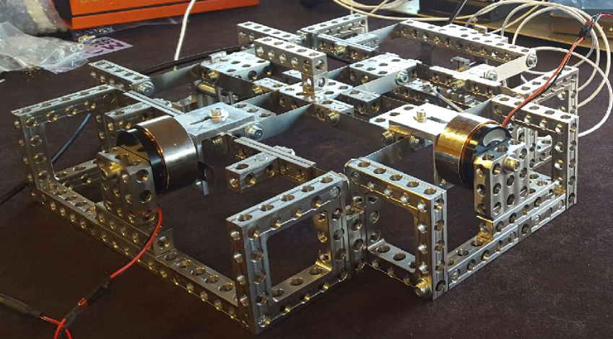
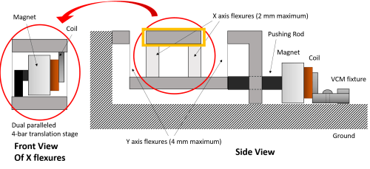

A short history
2015-Austin : Tuning fork penny scanner
2014- Boston : 3 improv challenges
Controls - controller design
Design - 3d printed micrometer
Metrology - uncertainty analysis
Participants:
Chinese university of Hong Kong
Georgia tech
Université Libre de Bruxelles
University of Michigan, Ann Arbor
University of North Carolina at Charlotte
University of Rochester
University of Texas Austin
https://www.motusmechanical.com/about-us#news-and-publicity
Participants:
Brunel university
Chinese university of Hong Kong
Cranfield university
Georgia tech
Katholieke Universiteit Leuven
Massachusetts Institute of Technology
University of North Carolina at Charlotte

Slide 4
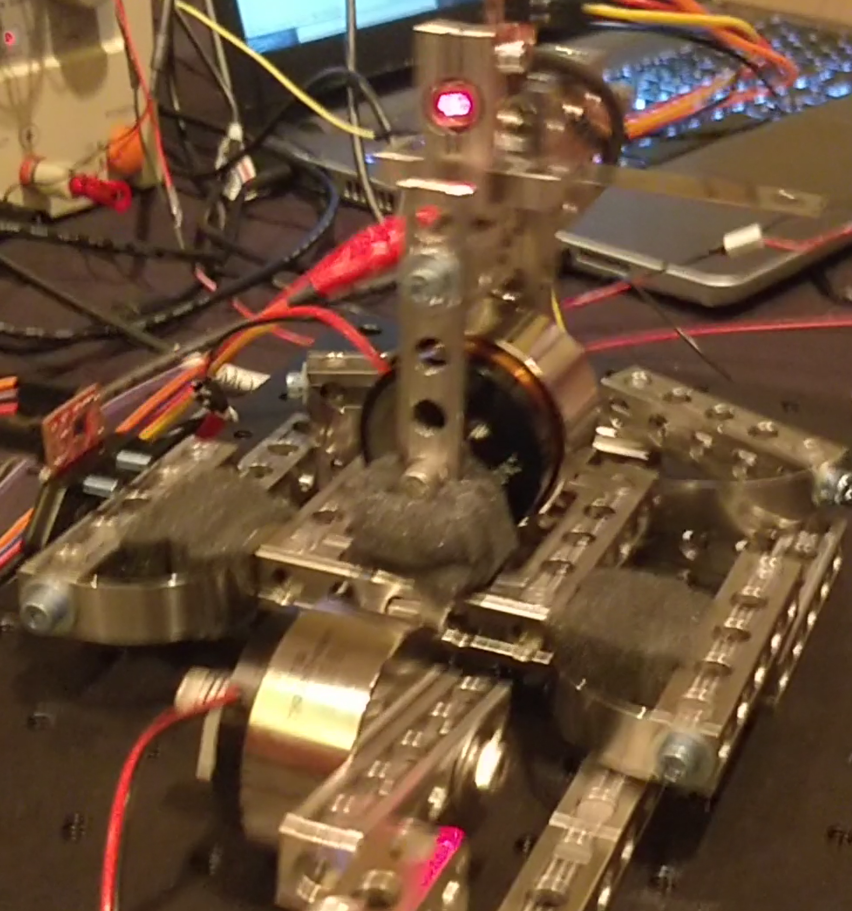
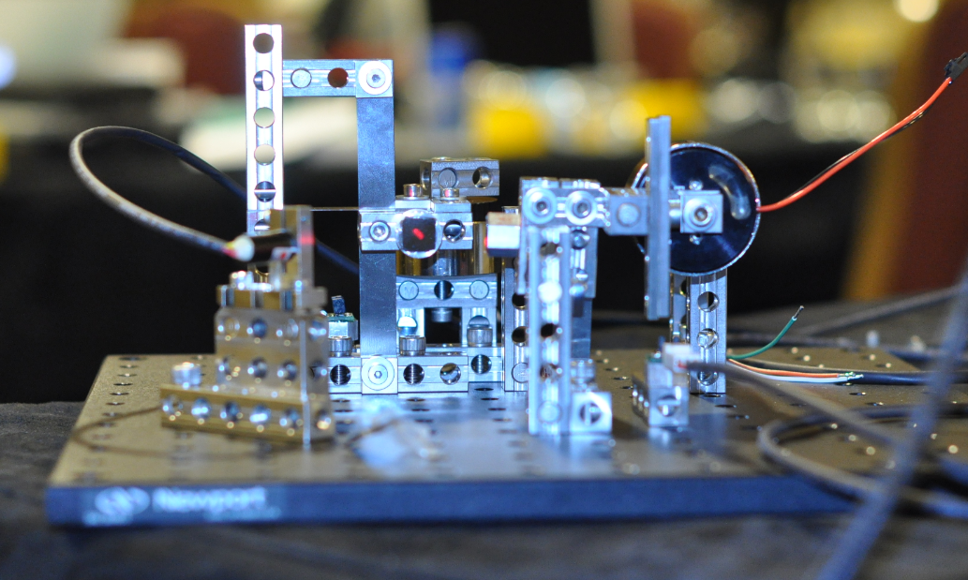
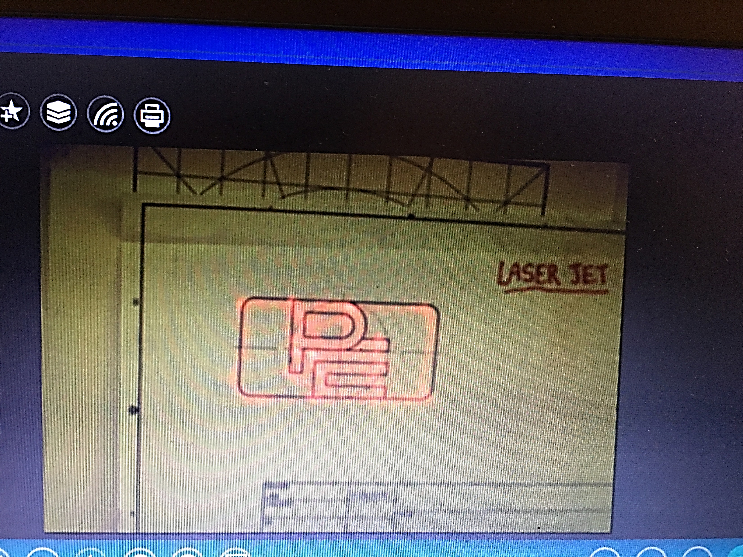
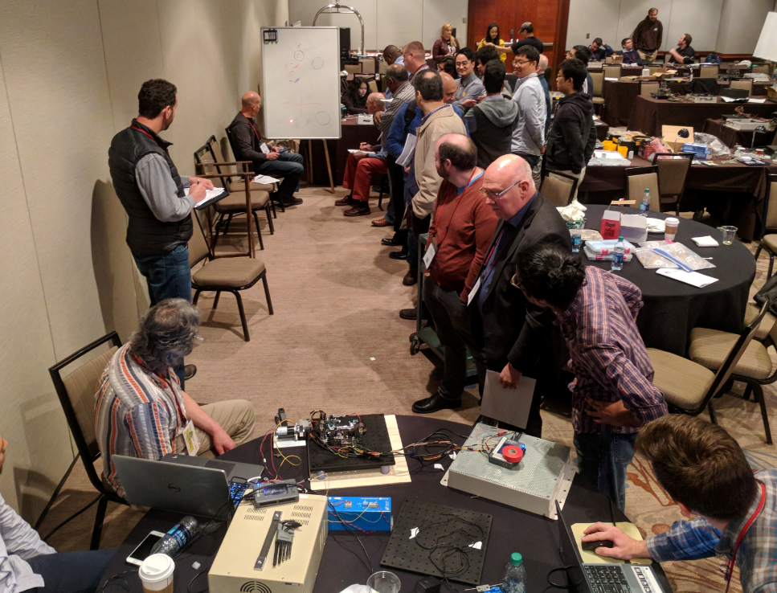
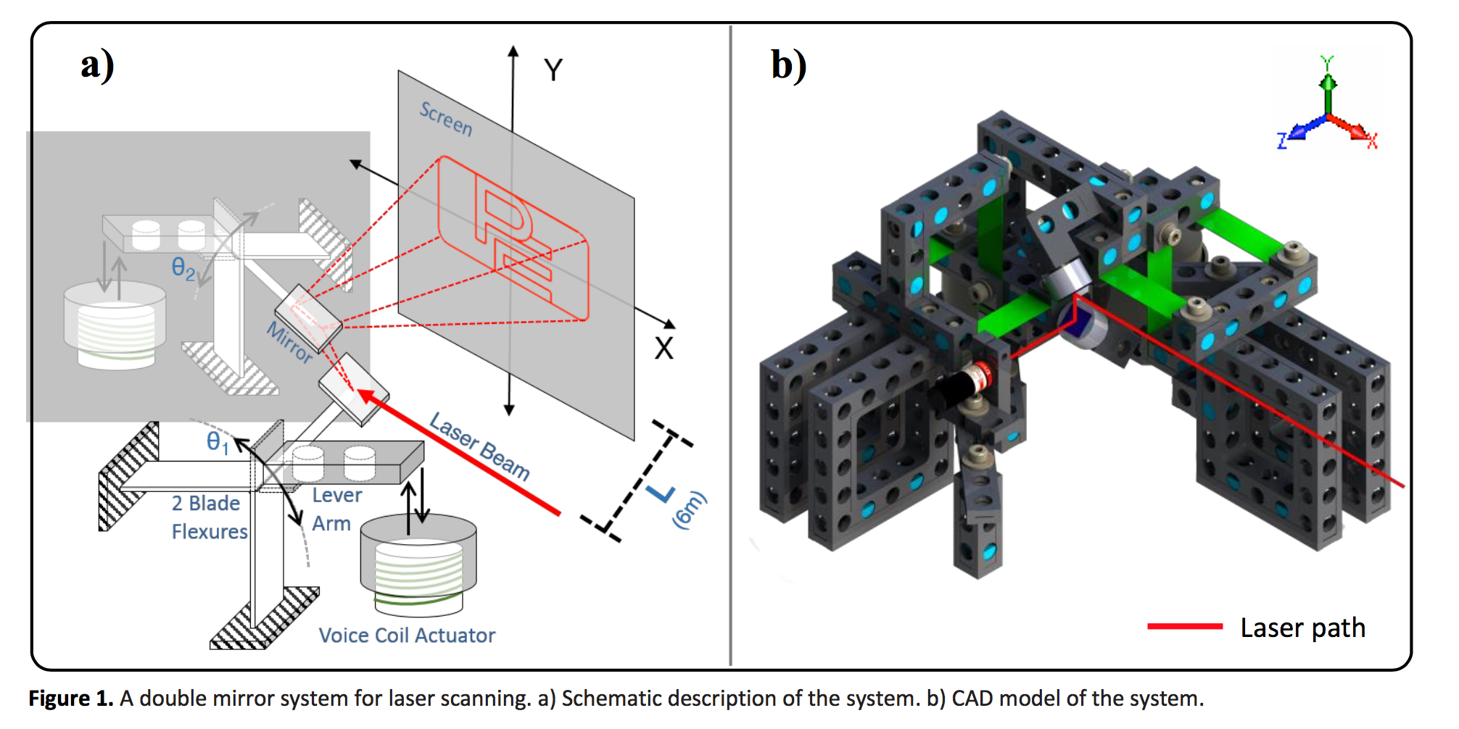
A short history
2016- Portland : Laser scanner writing PE logo
2017-Charlotte : Vibration isolation
Participants:
Massachusetts Institute of Technology
Navajo technical university
University of Michigan, Ann Arbor
University of Rochester X2
University of Texas Austin X 2
Optical breadboard being shaken with a DC motor
Participants:
Navajo technical university
UNC Charlotte X2
University of Nottingham
University of Rochester
University of Texas Austin

Slide 5
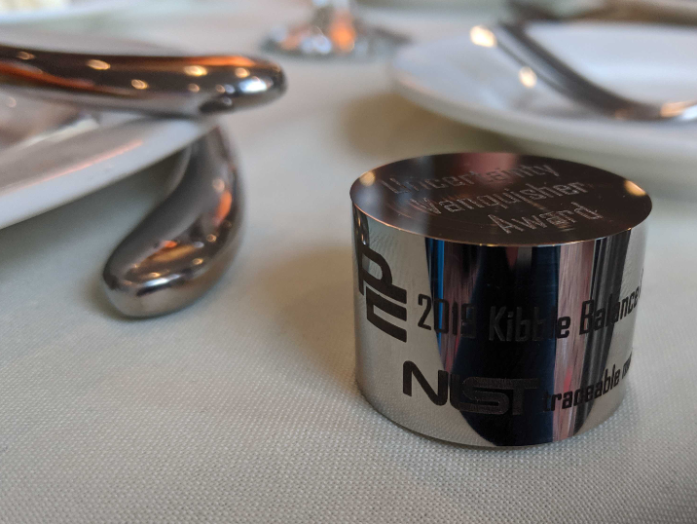
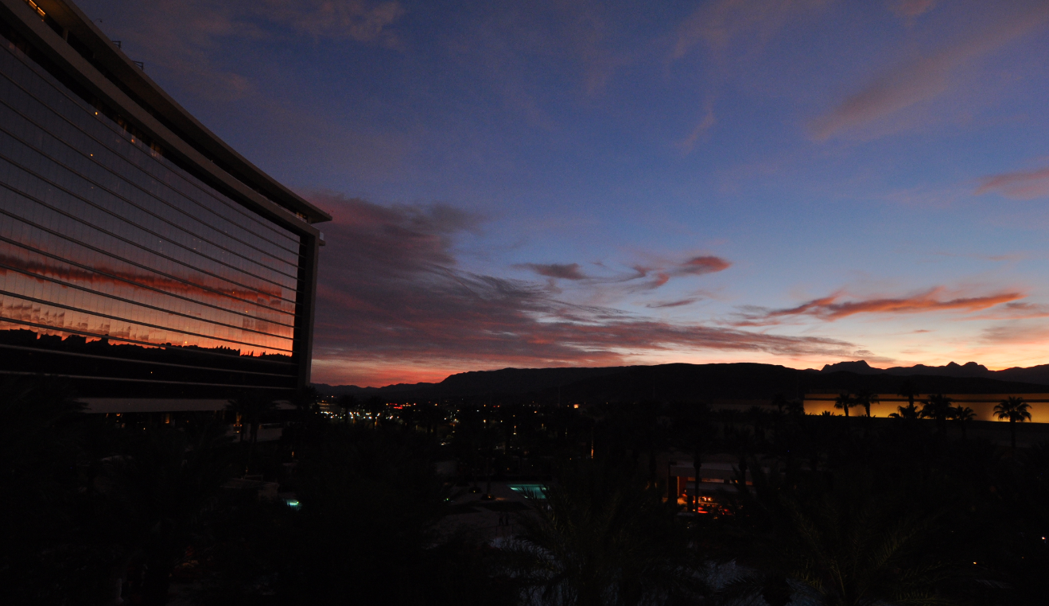
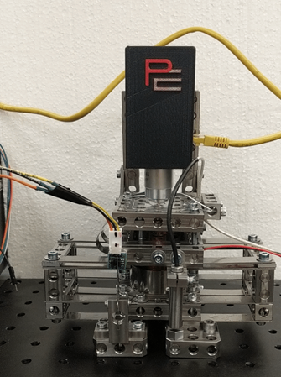
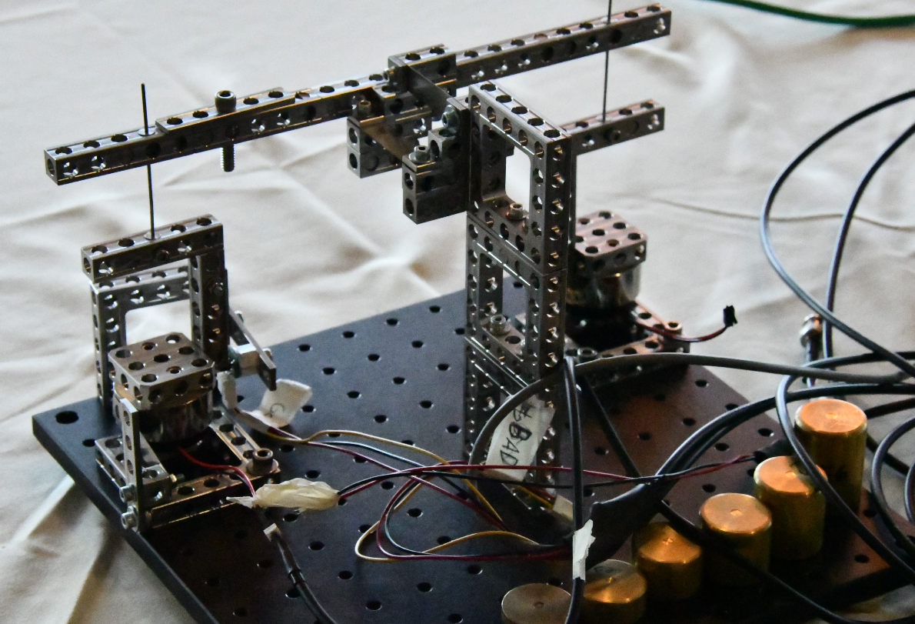
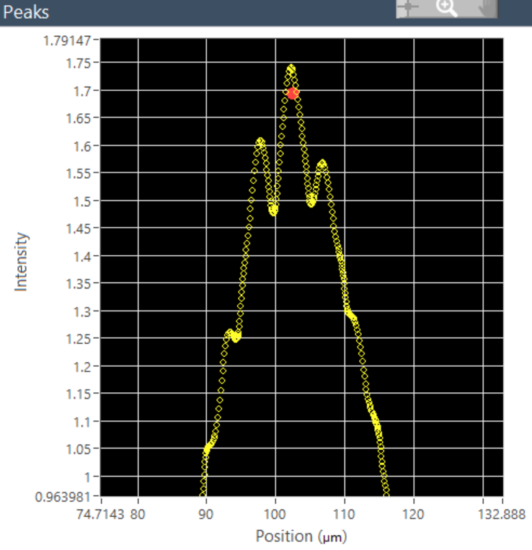
A short history
2018- Las Vegas : Thickness measurement of glass plates using a confocal microscope
2019-Pittsburgh : Kibble balance
Participants:
Chinese university of Hong Kong
Massachusetts Institute of Technology
Navajo technical university
University of Michigan, Ann Arbor
University of North Carolina at Charlotte
University of Texas Austin
Participants:
Chinese university of Hong Kong
Navajo technical university
Texas A&M
UNC Charlotte
University of Arizona & Rochester
University of Texas Austin
Due to the vibration in a hotel with a casino

Slide 6
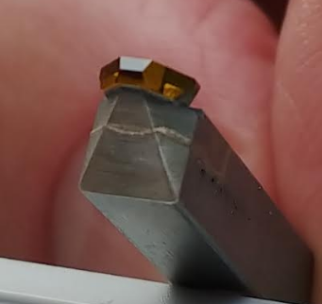
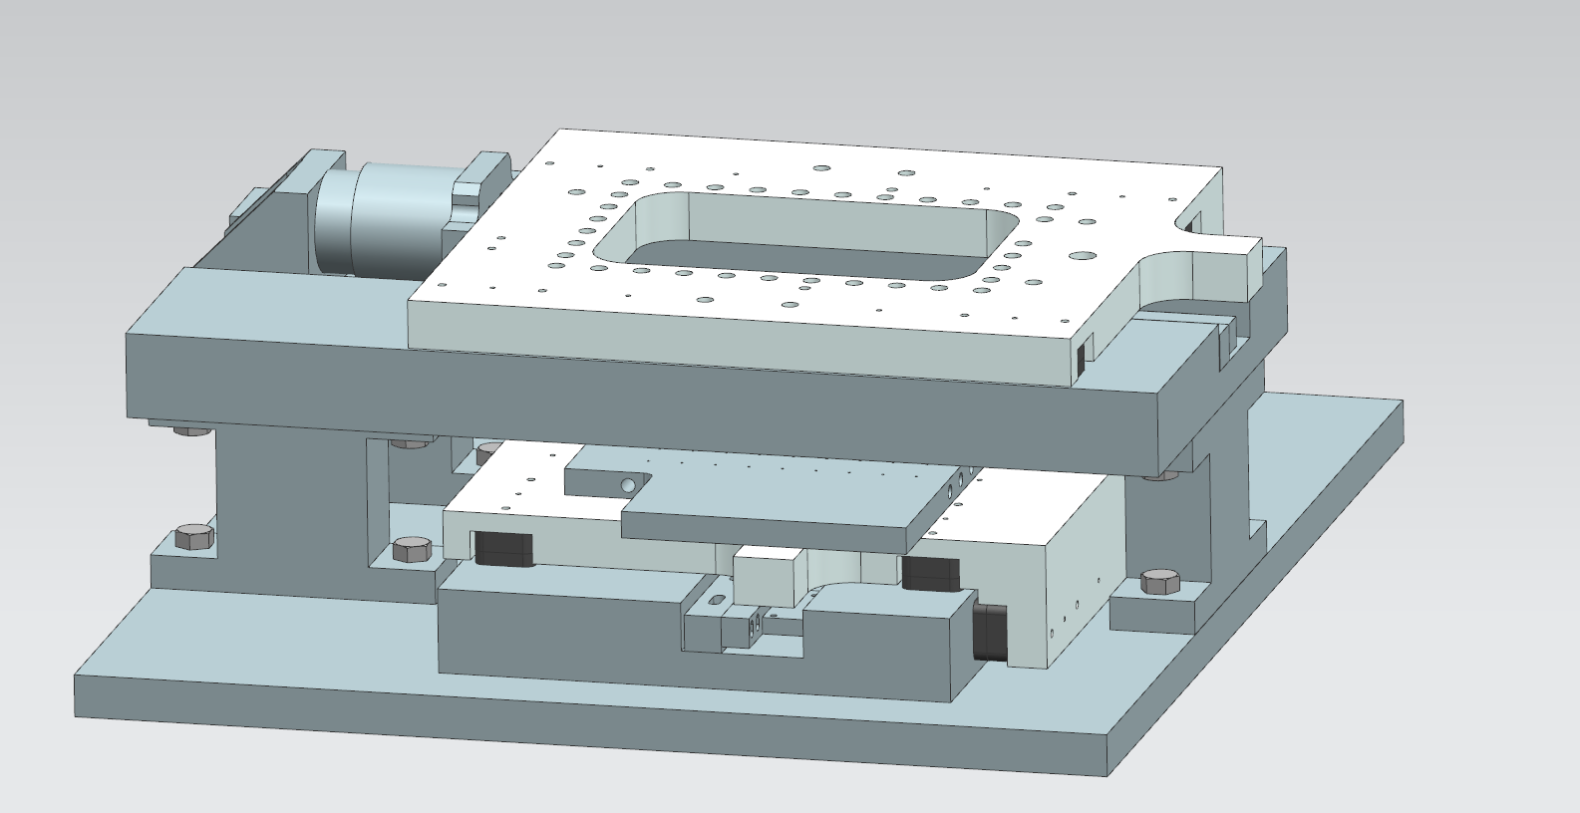
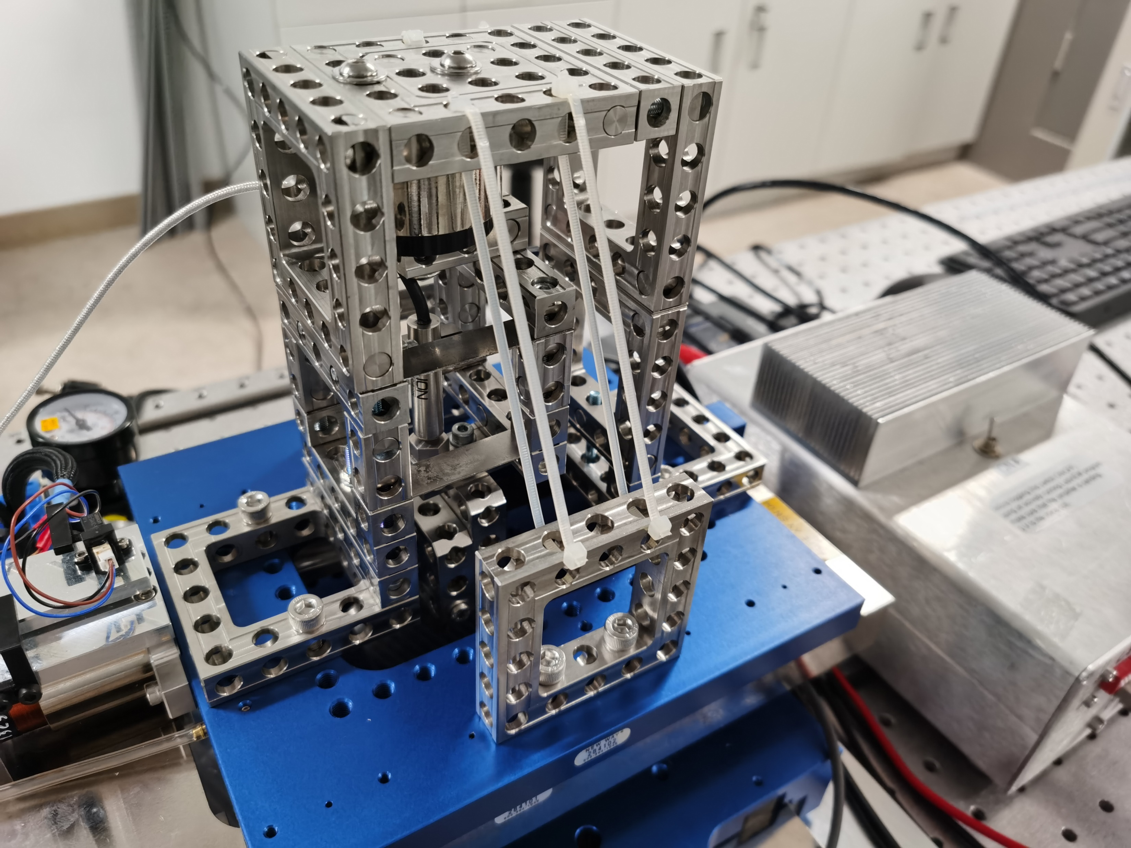
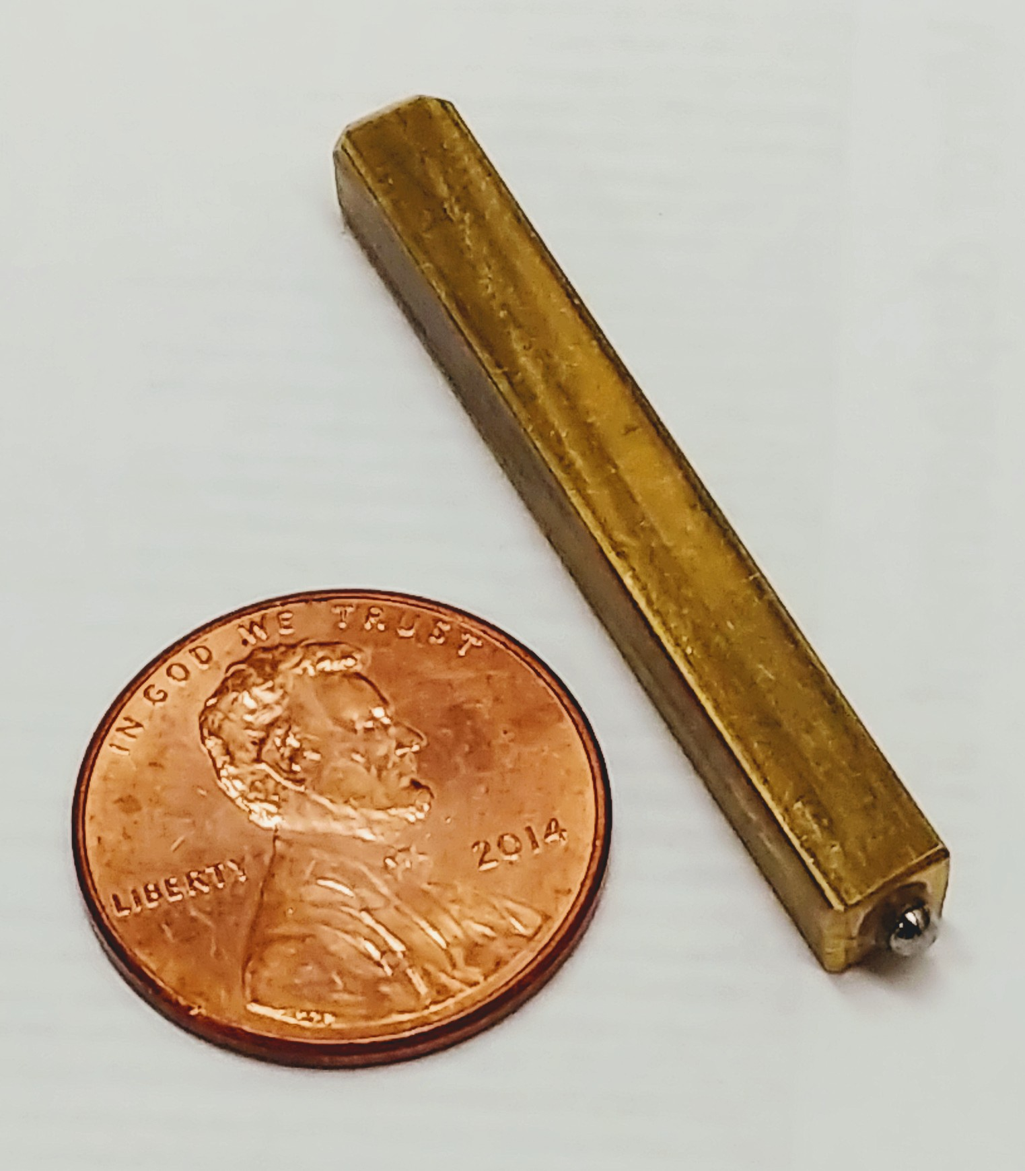
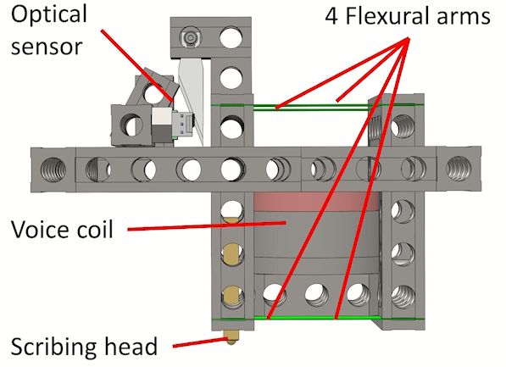
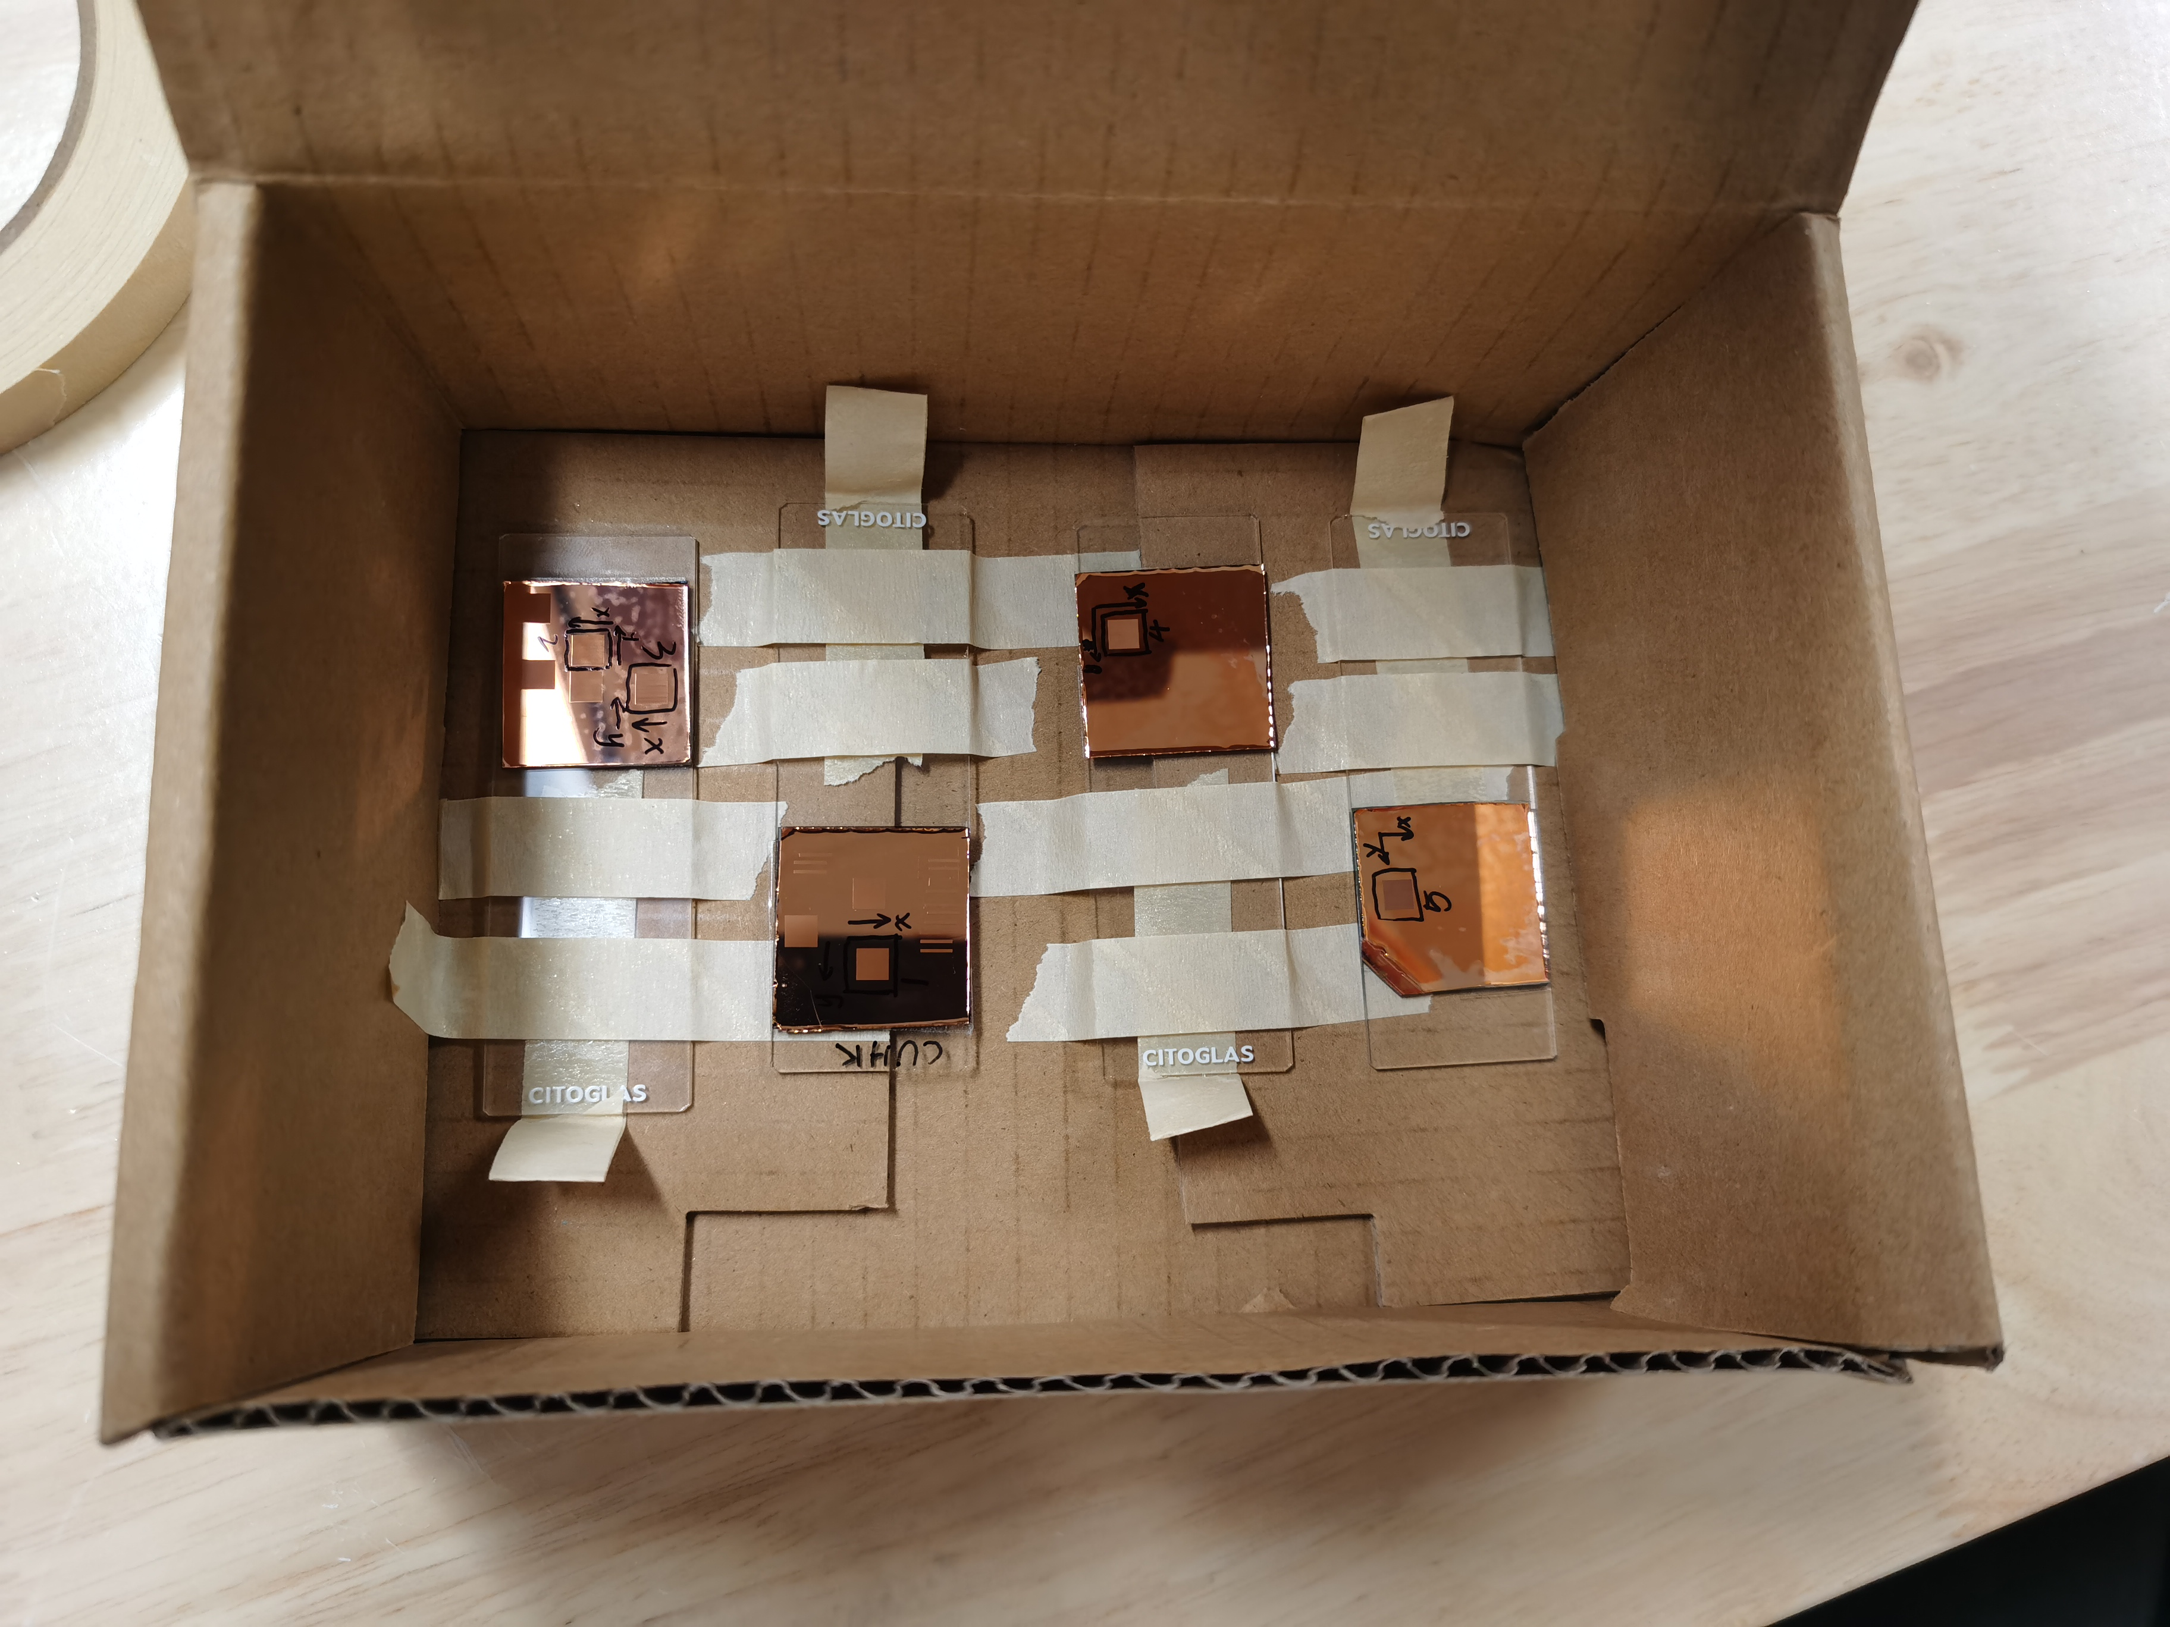
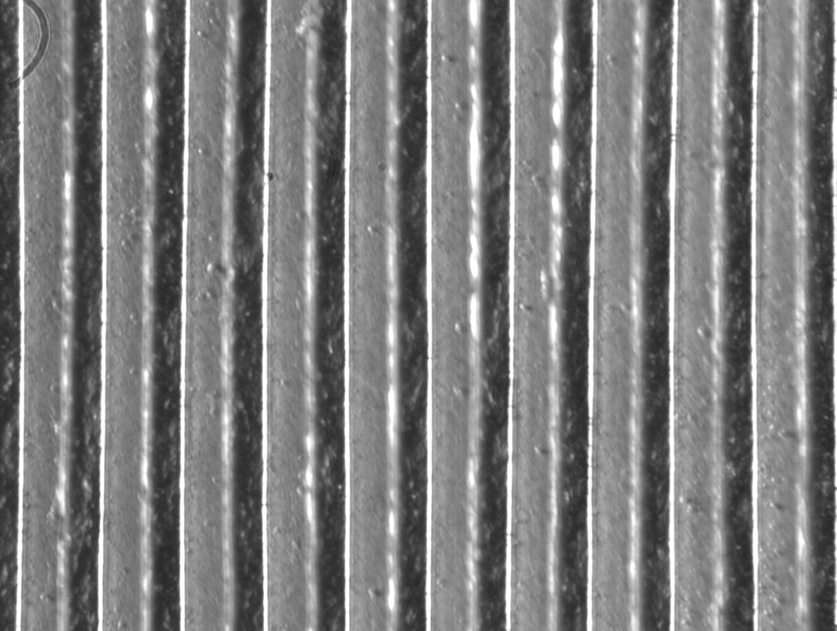
A short history
2020 ☹ - Virtual meeting: Force control of diffraction grating scribe tool
2021☺ Minneapolis - Hybrid : Diffraction grating manufacturing
Participants:
Chinese university of Hong Kong
Navajo technical university
Texas A&M
UNC Charlotte
University of Arizona
University of Texas Austin
Georgia Tech
Western university, Ontario
Dummy scribe tool
Participants:
Chinese university of Hong Kong
Navajo technical university
North Carolina state university
University of Michigan, Ann Arbor + Dearborn
University of Texas Austin

Slide 7
Student survey from 2021
What was the most valuable outcome of the competition ?
Networking and learning technology that isn’t offered at our school
Hands-on experience of troubling shooting a precision system
The deviation between simulation and experiment always exist.
A condensed hands-on experience on some of the precision hardware I didn’t have the opportunity to use in my research
(e.g. air bearing stages, capacitance sensor)
Networking with my peers in other universities that are working in similar projects
Mechanical knowledge
Finding optimal parameters of a completely unknown system.
Student Team spirit
The required precision to make such a precise part.
The single most valuable thing I learned during the event was to never give up, even
when all hope seems lost, and continue to pursue marginal success when the hardware
is fighting you every step of the way.
How to work with a team to manufacture gratings with um tolerances
Collaborative Work
Tenacity is the workhorse of root-cause-analysis.
Double check your work and make sure you keep track of all your data.
Teamwork
How to organize a research project
The process of debugging and analyzing problems
I got to meet other teams at different universities and got to learn about their research.

Slide 8
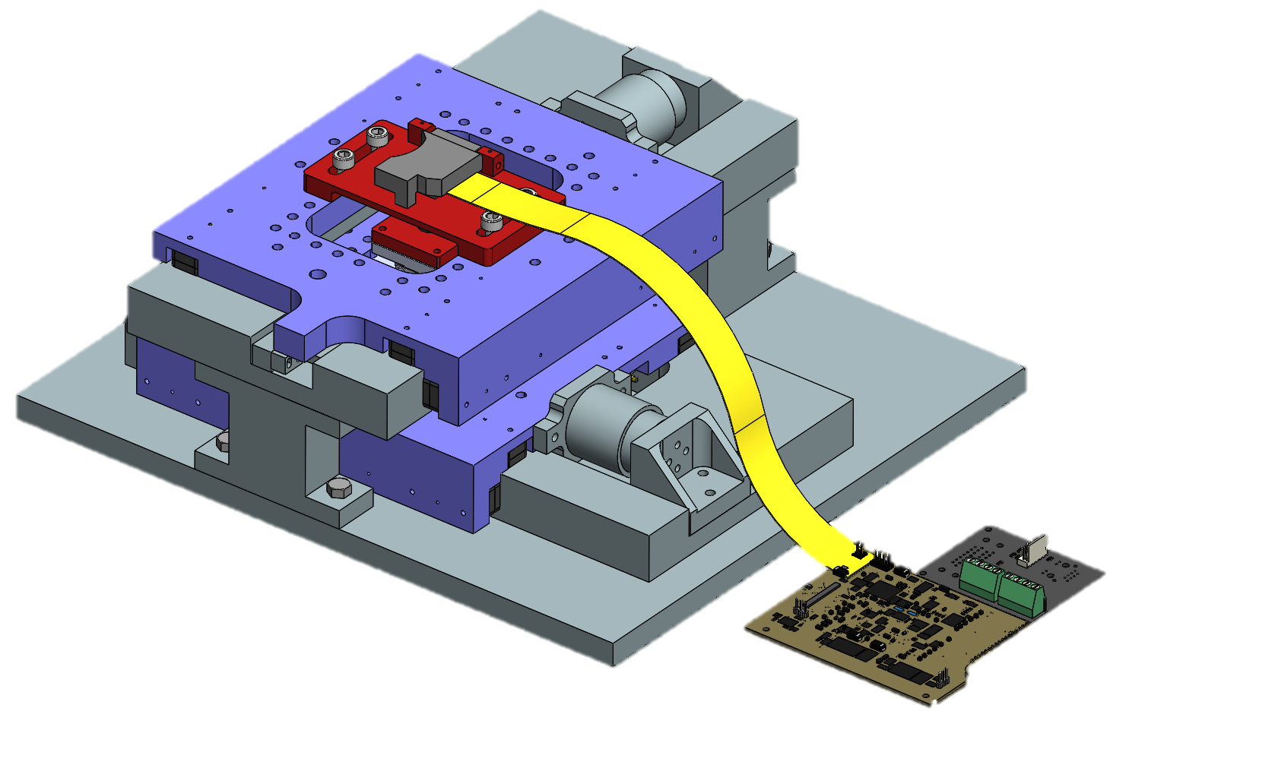
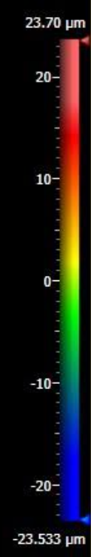
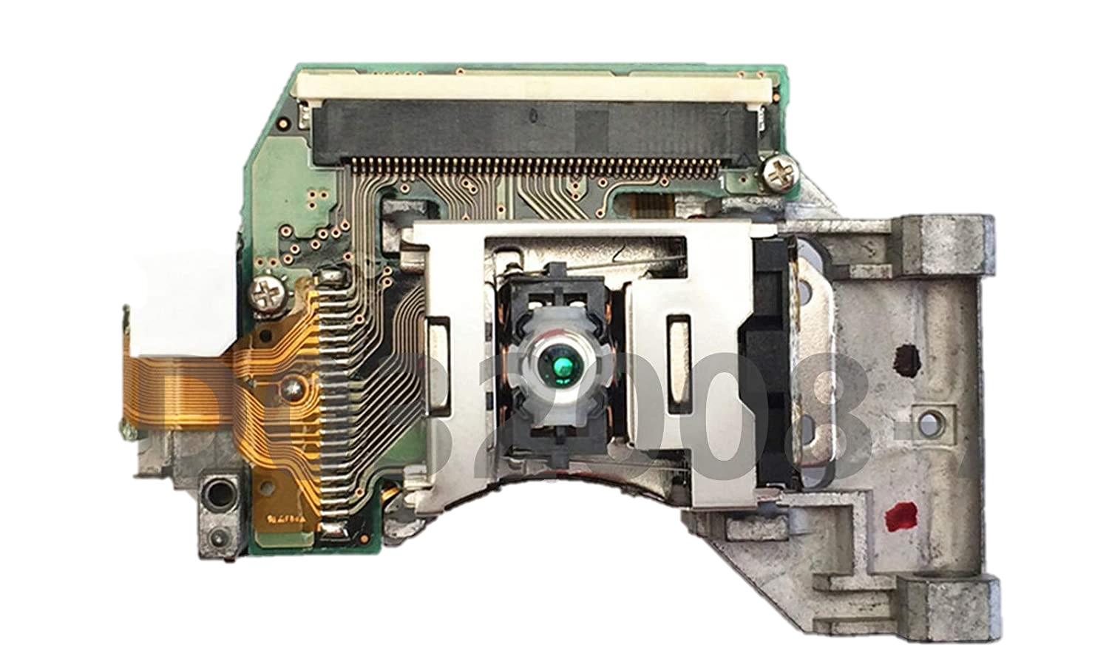
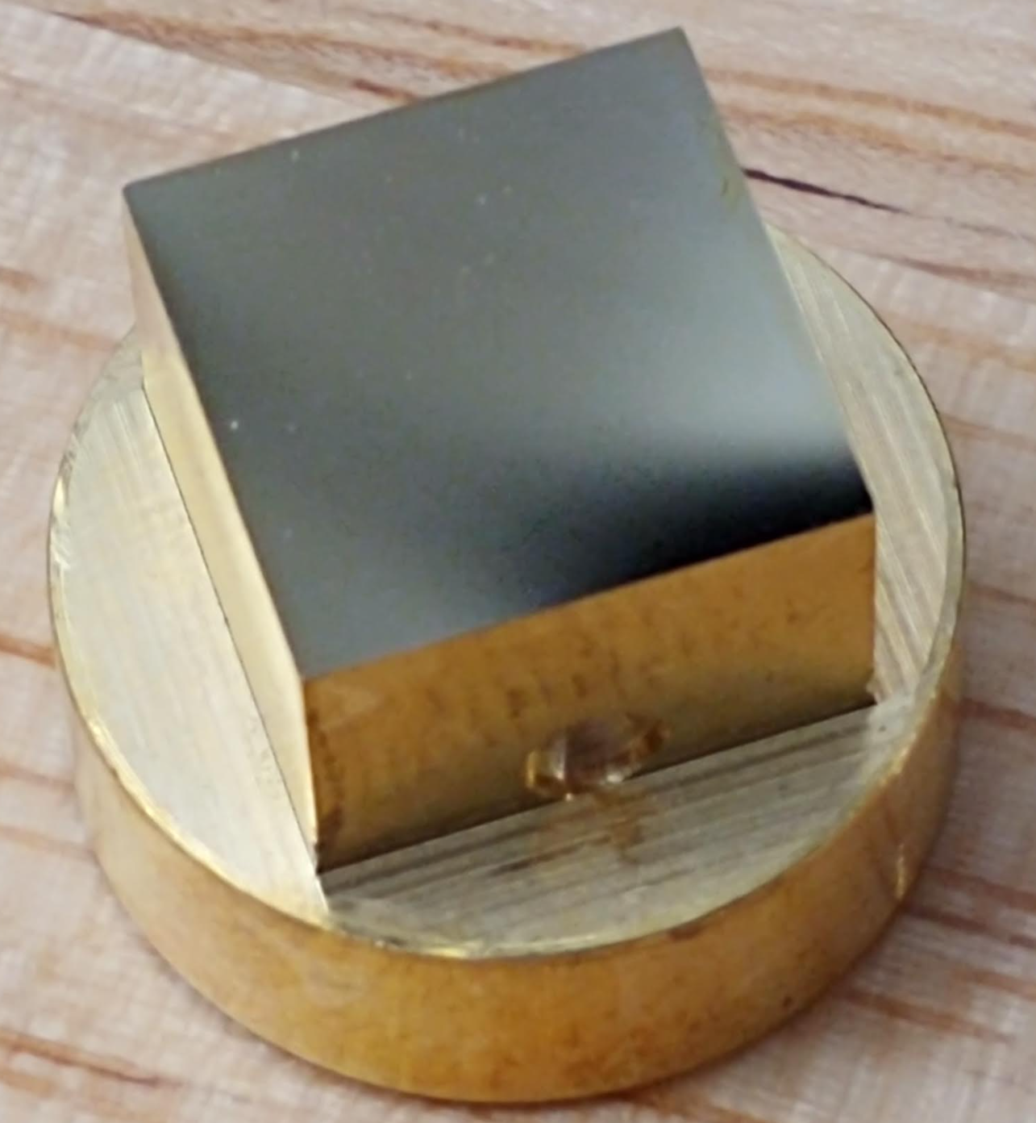
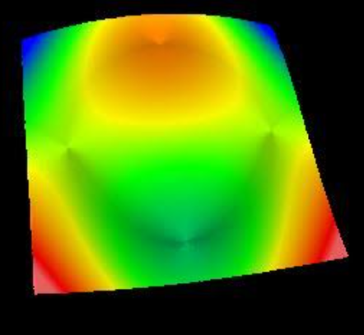
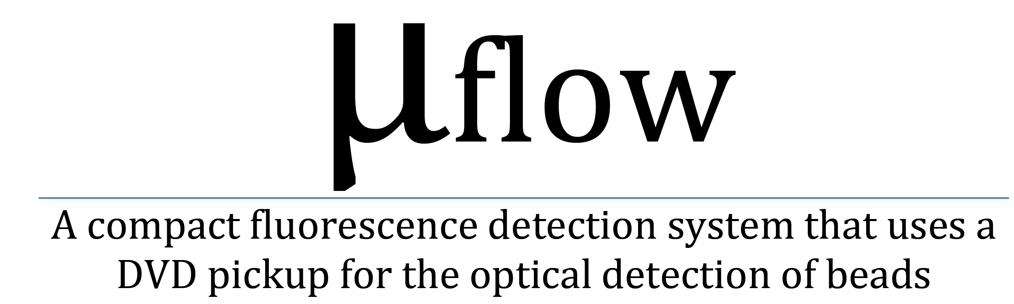
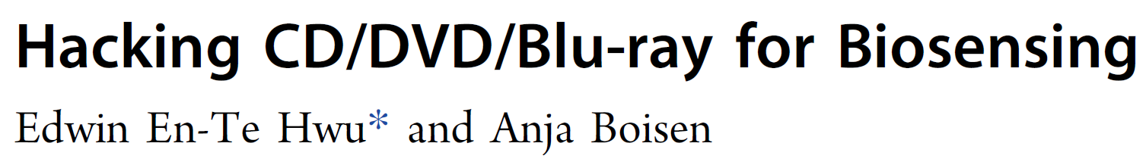


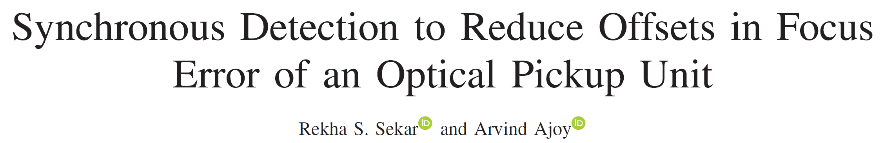
ASPE student challenge 2022
Optical profiling of Alvarez freeform mirror
25 µm
-10
-10
Optical Pickup Unit
PHR-803T
-25 µm
Participants:
Navajo technical university
UNC Charlotte
University of Arizona
University of Texas AustinX2
Auburn university + Ohio state university
Northwestern university

Slide 9
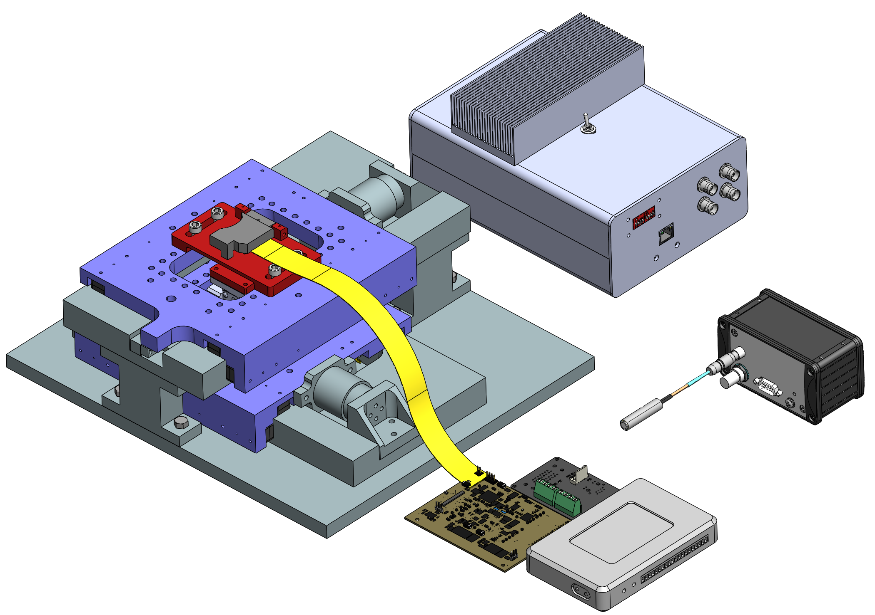
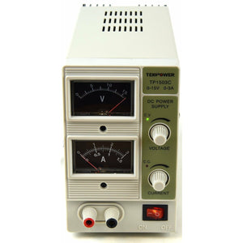
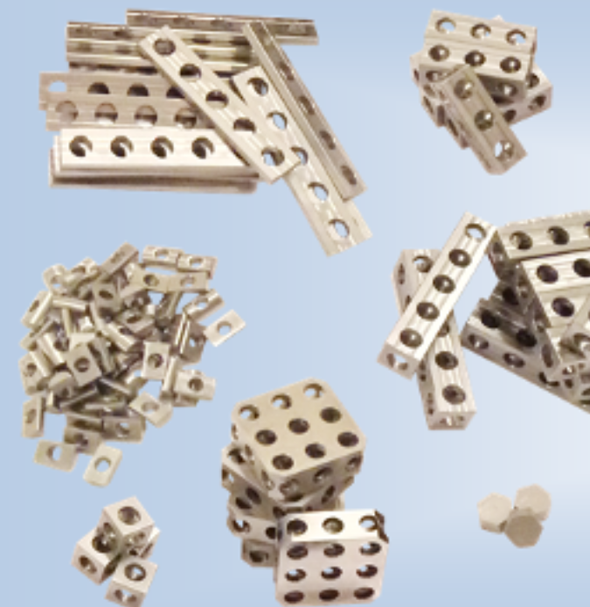
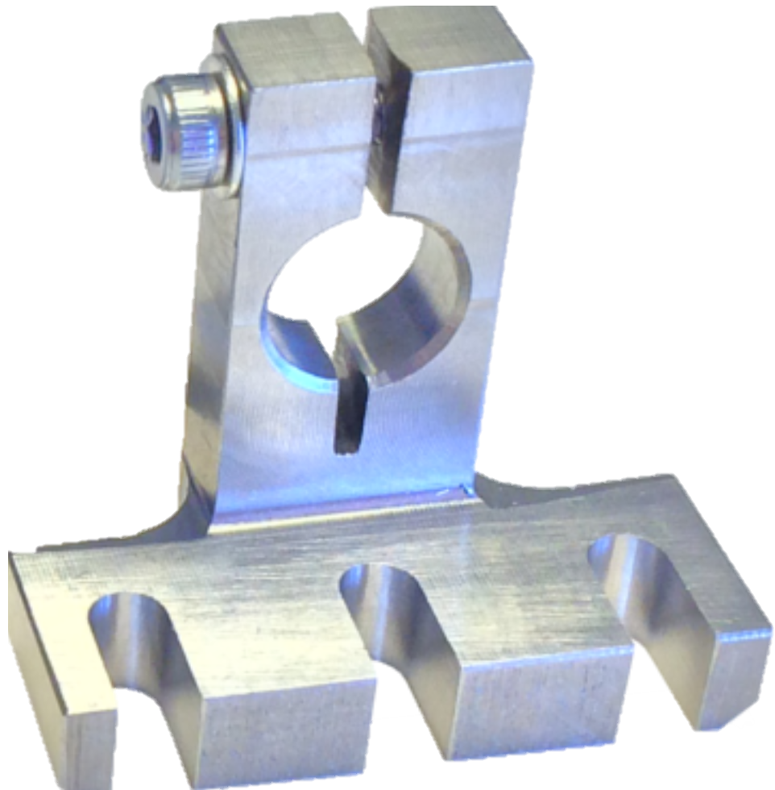
Committee provided equipment
Two 15 V, 3A Power supplies
16-bit capable Data acquisition and current amplifier unit
y-axis air bearing stage
Adapter plate for the OPU
Optical pickup unit (OPU)
OPU
PHR-803T
Adapter plate for the specimen
z
y
45 pin flexible flat cable (FFC)
x
PCB to communicate to 16-bit DAQ/Amp, and XY stage encoders
Capacitance probe and its holder
z-axis micrometer stage (LZ40)
on an adapter plate (not shown) to attach to the x-axis stage
x-axis air bearing stage
PCB to read and control the OPU
NI-myRIO microcontroller (not provided)
Mechblocks (see slide 14) to attach the probe to the XY stage, and for other purposes

Slide 10
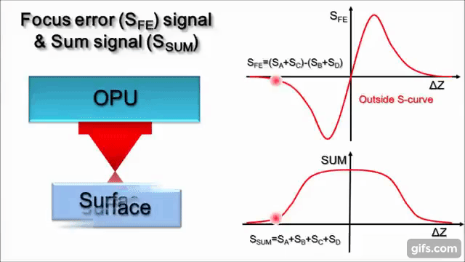
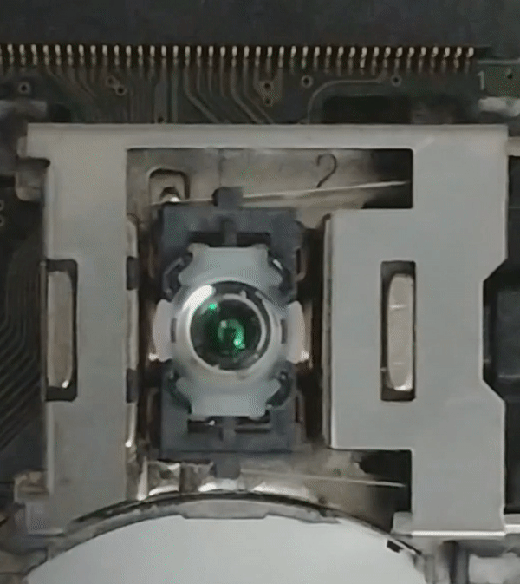
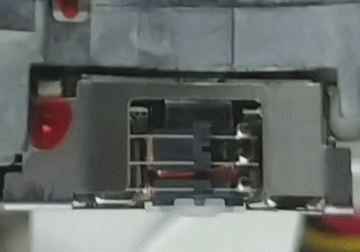
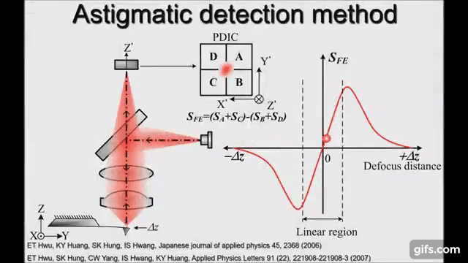
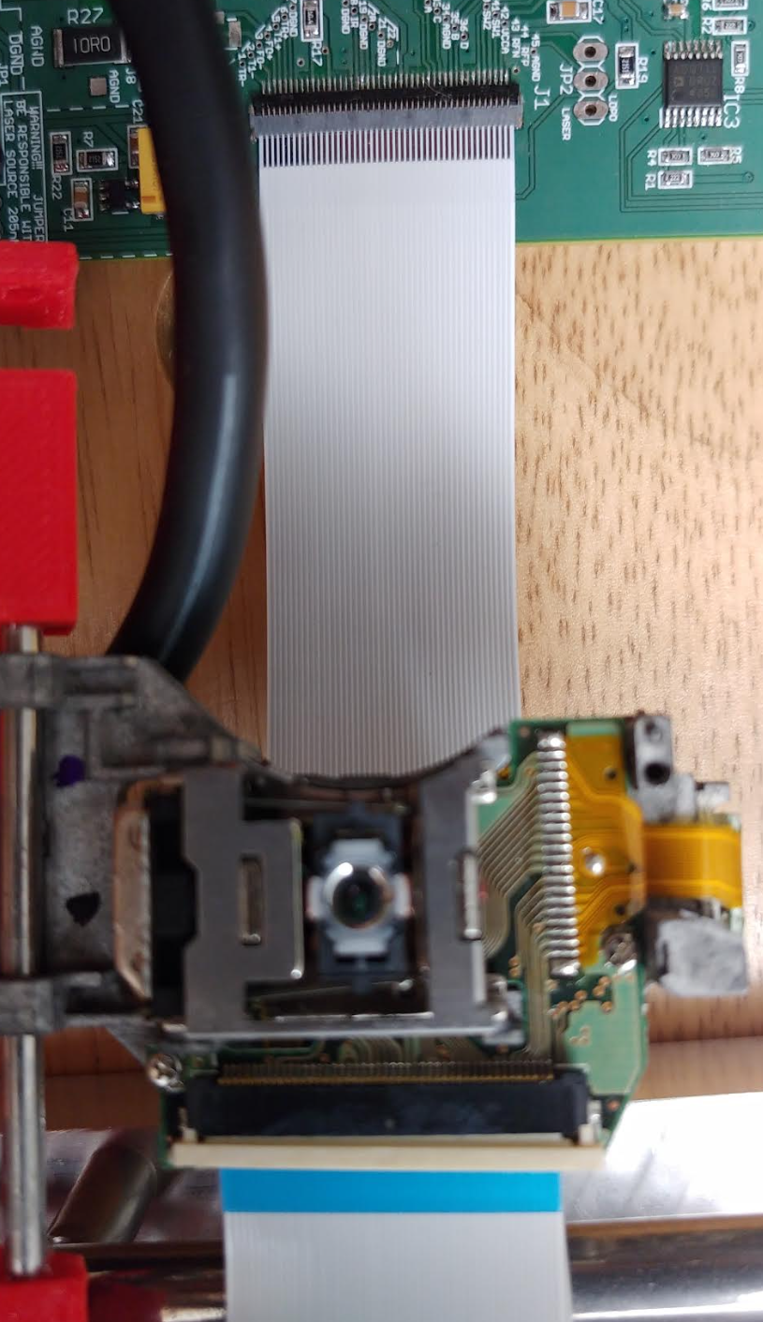

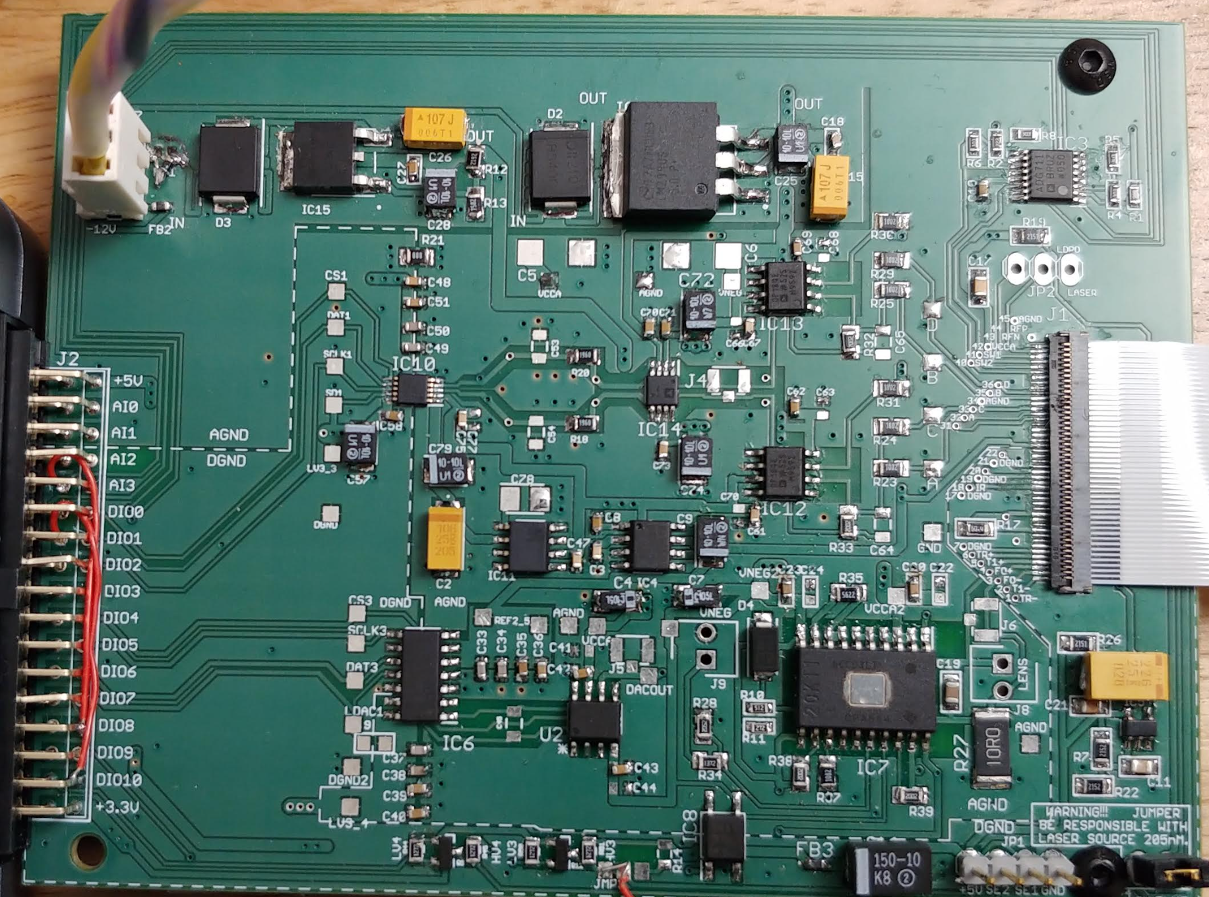
Optical pickup unit
Focus error signal
x
z
Confocal signal
OPU
PHR-803T
Parallel guidance Wire flexures
Focusing lens
Committee provided PCB has z-axis actuation and Focus error signal capabilities only
Wear antistatic strap if in low humidity environment
At the PCB side, 45 pin FFC cable should have the silver side
At the OPU lens side, cable should have the blue strip
https://www.youtube.com/watch?v=5bqujaldaCQ

Slide 11
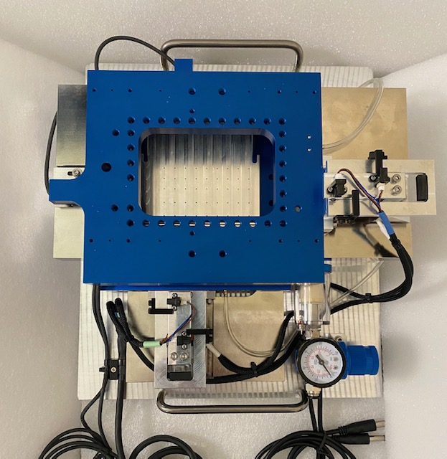
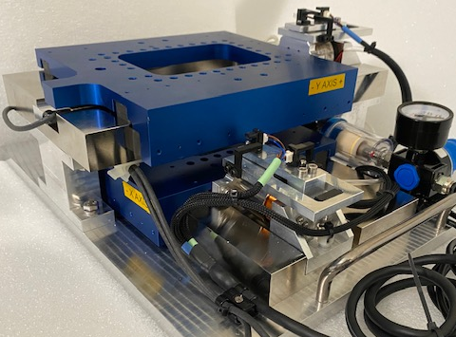
XY air bearing stages
optical trigger limit switch (Y)
Air filter and pressure regulator
Voice coil actuator (Y)
Y carriage
Air supply in
Linear encoder (Y)
optical trigger limit switch (X)
Handle
X carriage
Voice coil actuator (X)
elastomer attached to end stop bracket (X)
Nickel plated Steel guideway (Y)
Z stage to control the scribe tool force will get attached on top of Y carriage
250 mm

Slide 12
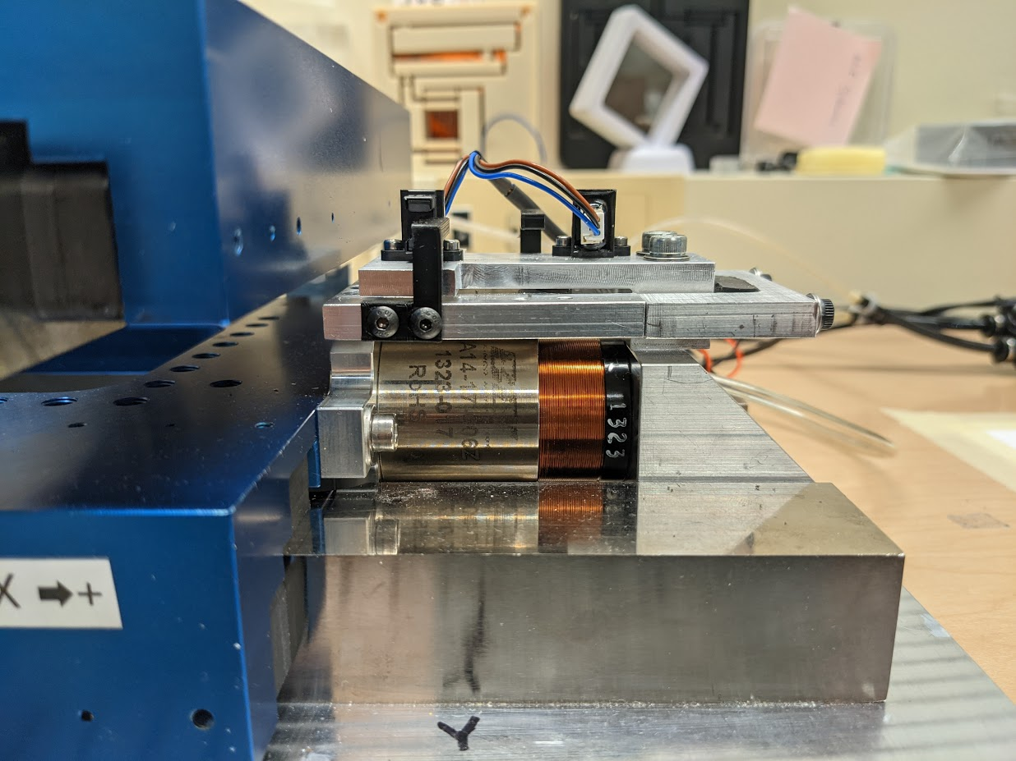
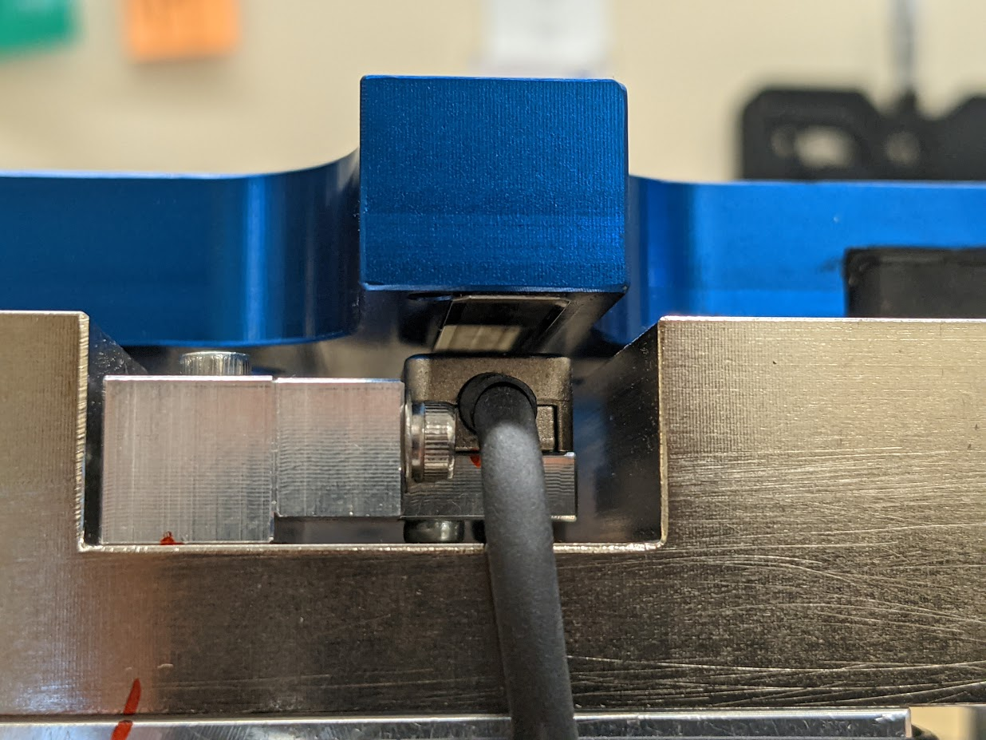
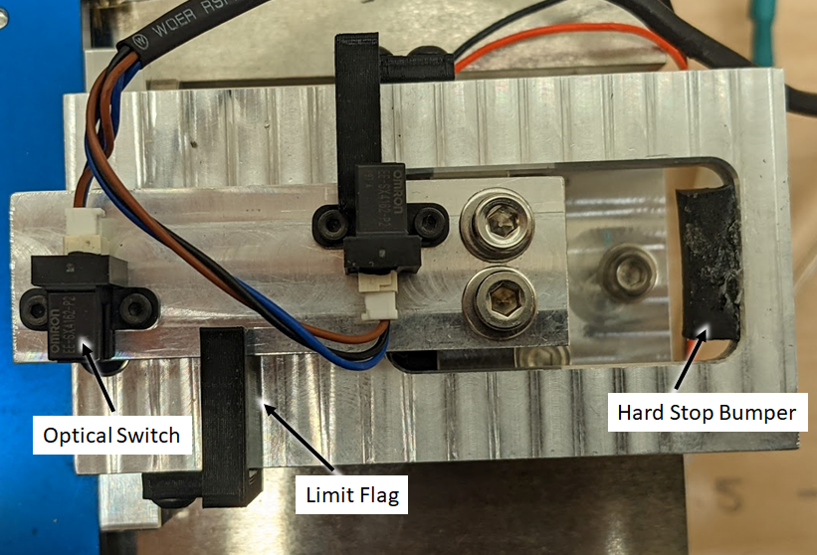
Line scale attached to the moving carriage
Linear encoder read head attached to the guideway
Voice coil actuator for the X carriage
Optical limit switch
Hard stop rubber bumper
Limit flag

Slide 13
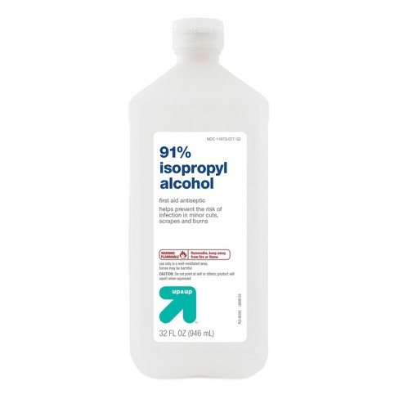
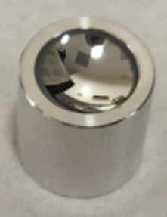
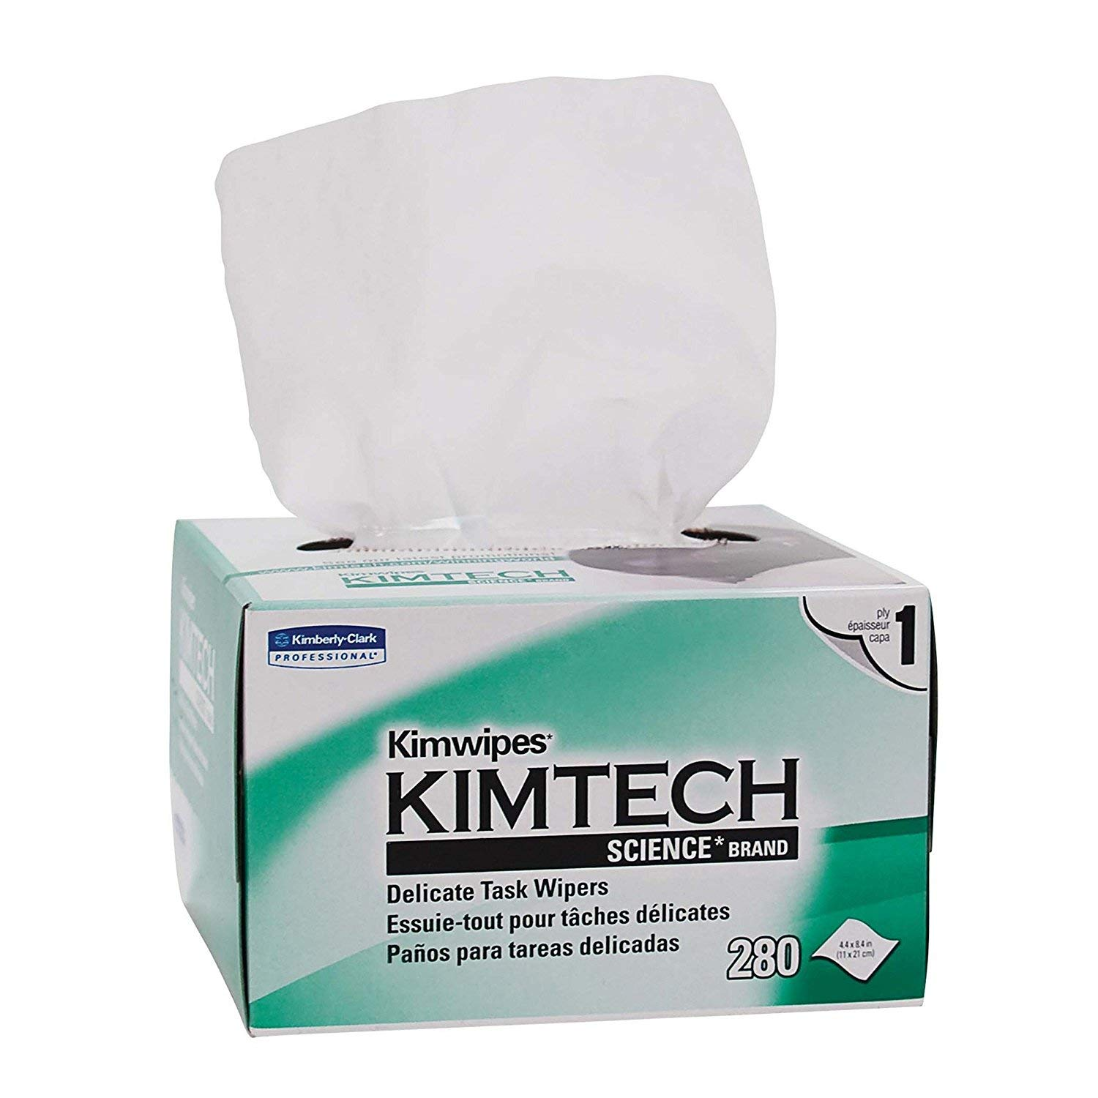
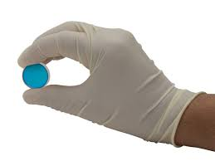



Committee provided specimens
Specimen handling
1. Test object
Concave Mirror, 9mm Dia. x 4.5mm FL
Protected Aluminum
STOCK #43-674
Can be used for hardware setup before using the Alvarez mirror
23.70 µm
2. Team Alvarez freeform sample
Alvarez brass mirror, 10 mm², 48 µm PV
-10
-10
-23.53 µm

